Slide 1
Portal for managing academic course videos
JITEsh gawas – 22m0748
Gaurang Athavale – 22m0774

Slide 2
Description
Portal for managing academic course videos
Admin Section: Admin can monitor (Approve and Reject) videos by verifying if the video is educational . Admin can also add coursess for each video. Videos will be visible to all other users only after admin approves the video
User Section: Users have to register themselves and login to the portal. Users can upload the videos and post verification, the videos will be available to everyone. Users can also see the status of videos. Users can edit and delete there uploaded videos.

Slide 3
Description
After user login, the user can see the section of ‘All Videos’ and also his/her uploaded videos under ‘My Videos’ section. If the user is admin, the admin has the option to add course or delete course under ‘Manage Course’ section. Admin also has the option to approve or delete the video under ‘Manage Videos’ section
Videos Section: Each video has a title, course and a description. Each video also has number of likes, comments by all users. Video controls such as restart, +5sec, -5sec .

Slide 4
What have we achieved
We were able to develop a complete running system using the below mentioned tools and learnt to integrate all the tools together.
Tools we were able to learn
SpringBoot
Java
Postgres
Angular
Inkscape
Git

Slide 5
Future scope
System can be scaled to individual organizations using their organization domain name. (Eg. Moodle is used based on each organization’s domain name and this can be used in a similar fashion for managing course videos)
In-Video quizzes can be further added to make the content more interactive.
We can also add subscription to the course and then users can also see the subscribed course videos.

Slide 6
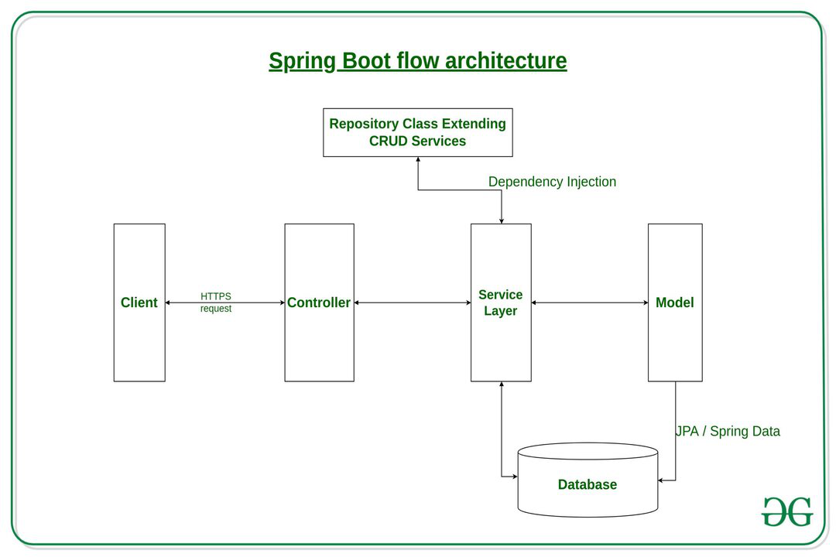
Flow of the software

Slide 7
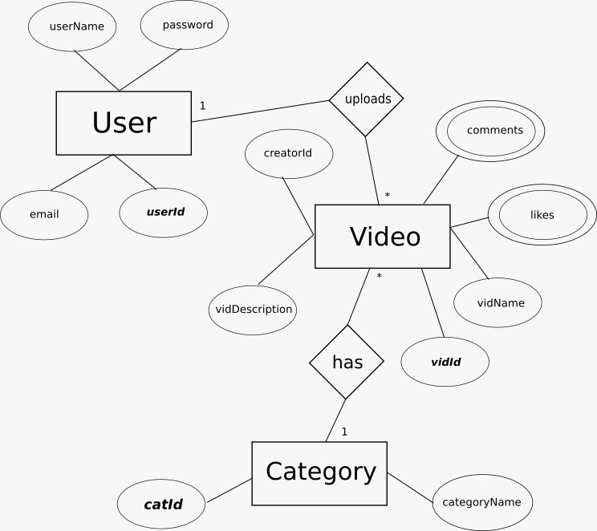
ER MODEL and database connections

Slide 8
Directories/ File Structure
A client sends a request to controller of each model.
Controller further send the request with required information to the service layer.
Service layer further send the request to the Data Acces Layer (DAO File)
Dao File further interacts with database with required query to insert, update or delete the data as per the requirement.

Slide 9
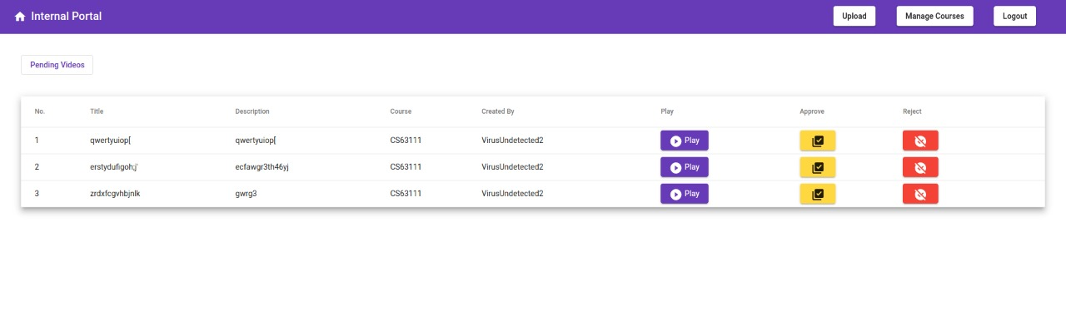
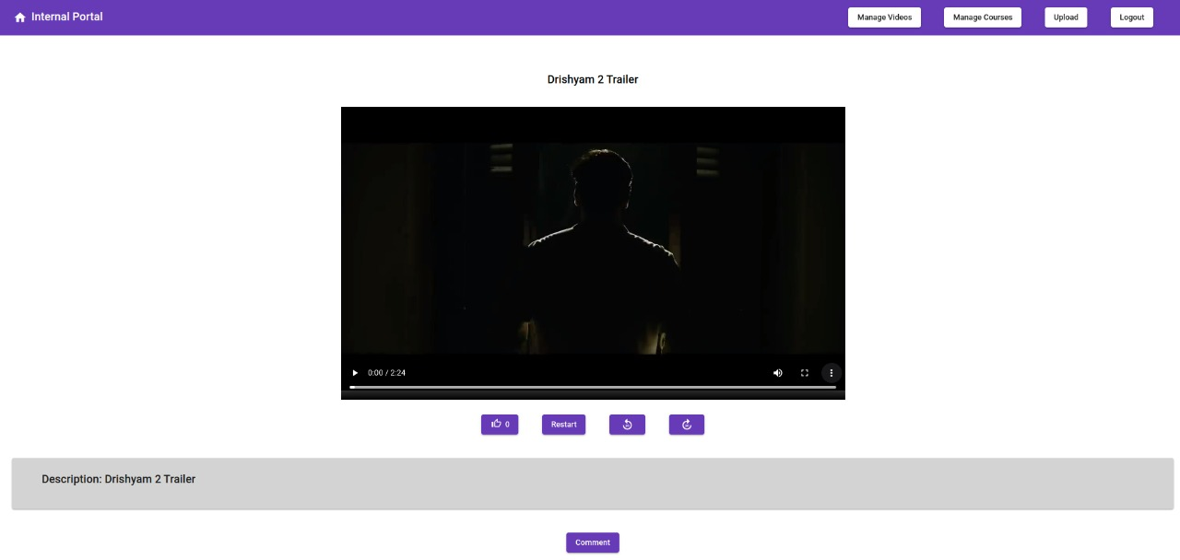
Implementation

Slide 10
Compilation / running instructions
Initialization: Run the sql.txt file to create all the required tables
Angular Installation and Running:
$ npm i
$ npm start
Backend Installation and Running:
Open the project in IntelliJ IDEA as Spring Project
Download the postgresql jar file from (https://jdbc.postgresql.org/download/) and import it in the the project: File > Project Structure > Libraries >
Change the database name and password in application.properties file, and localhost port number (if changed while installing postgres/pgAdmin4)
Run the Project as Spring Application

Slide 11
THANK YOU

